Slide 1
GAME THEORY
A PRESENTATION BY ANIKET SAHRAN (102018065) AND DIVIJA (102018056)

Slide 2
Shall we play a game?
1
Well! It’s not that easy.
Notes:
Let’s get your brain to work!

Slide 3
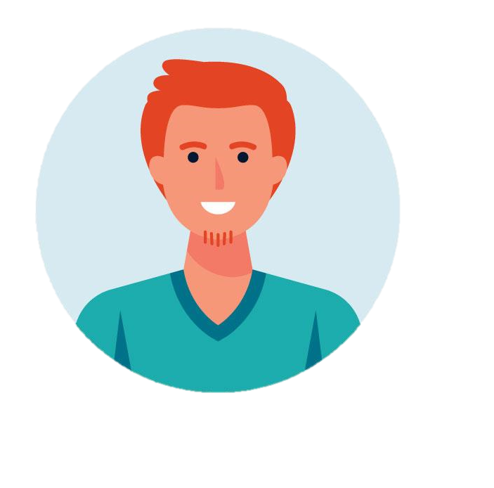
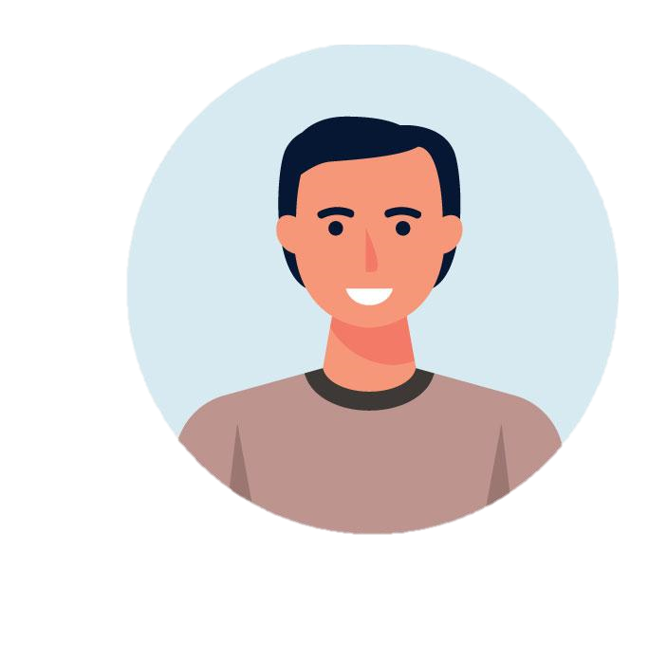


What are the rules?
0
100
2/3
Notes:
Suppose y’all are given a range of integers from 0 to 100, you have to guess the whole number closest to 2/3 of the average of all numbers guessed.
Let me explain it to you, suppose these four people are playing a game and they choose
80, 70, 50, 40
What number do you think was the correct guess at 2/3 of the average?
So if the average of all guesses is 60, the correct guess will be 40.

Slide 4

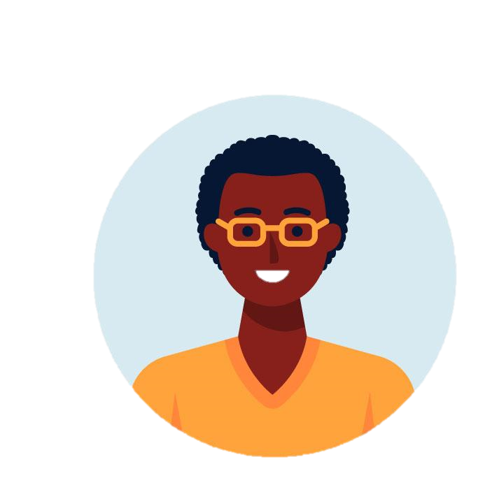



Reasoning our way to the answer.
One condition for the game
Common Knowledge.
Notes:
Let’s see if we can try and reason our way to the answer…
This game is played under conditions known to game theorists as common knowledge.
Not only does every player have the same info , they also know everyone else does, and that everyone else knows that everyone else does and so on infinitely.

Slide 5
Reasoning our way to the answer.
44
67
100
Notes:
Now the highest possible average would occur if everyone guesses 100.
In that case , the 2/3 would be 66.66
Since everyone can figure this out , it would’t make sense to guess any number higher than 67.
If everyone playing comes to this same conclusion,
no one will guess higher than 67.

Slide 6
Reasoning our way to the answer.
29
44
67
Notes:
Now 67 is the new highest possible average,
so no reasonable guess should be higher than ⅔ of that, which is 44.
This logic can be extended further and further

Slide 7
Nash Equilibrium
Highest possible logical answer keeps getting smaller
Hence, the most sensible answer will be minimum number possible – 0.
A state where every player has chosen the best possible strategy for themselves, given everyone else playing and no individual player can benefit by choosing differently.
0
29
44
Notes:
With each step, the highest possible logical answer keeps getting smaller.
So it would seem sensible to guess the lowest number possible.
And indeed, if everyone chose zero,
the game would reach what’s known as a Nash Equilibrium. A state where every player has chosen the best possible strategy for themselves, given everyone else playing and no individual player can benefit by choosing differently.

Slide 8
Real World Scenario
People aren’t perfectly rational.
Don’t expect each other to be perfectly rational.
In real world settings, the average tends to between 20 and 35.
Notes:
But, that’s not what happens in the real world.
People, as it turns out, either aren’t perfectly rational,
or don’t expect each other to be perfectly rational.
Or, perhaps, it’s some combination of the two.
When this game is played in real-world settings,
the average tends to be somewhere between 20 and 35.

Slide 9
K-Level Reasoning
Player at level 0 approaches naively.
At K-Level 1, player assumes everyone is playing at level 0.
Average of 50 - guesses 33
At K-Level 2, player assumes everyone is playing at level 1
It would take 12 K-Levels to reach 0.
Notes:
Economic game theorists have a way of modeling this interplay
between rationality and practicality called k-level reasoning.
K stands for the number of times a cycle of reasoning is repeated.
A person playing at k-level 0 would approach our game naively,
At k-level 1, a player would assume everyone else was playing at level 0,
resulting in an average of 50, and thus guess 33.
At k-level 2, they’d assume that everyone else was playing at level 1,
leading them to guess 22.
It would take 12 k-levels to reach 0.

Slide 10
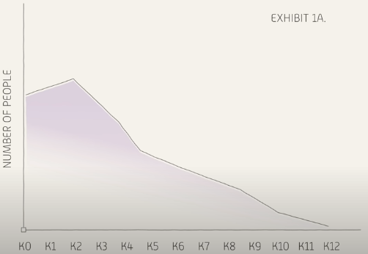
K-Level Reasoning
Most people stop at K-Level 1 or 2.
K -level thinks comes into play in high stakes situations.
Notes:
The evidence suggests that most people stop at 1 or 2 k-levels.
And that’s useful to know,
because k-level thinking comes into play in high-stakes situations.

Slide 11
The Benefit of knowing the Answer.
Stock traders evaluate stocks not only based on the earnings report, but also on the values that others place on those numbers.
Penalty kicks – both shooter and the goolie decide whether to go right or left based on what the other person is thinking
Participants must weigh their own understanding of the best course of action and how well they think other participants understand the situation
But 1-2 K-Levels is by no means a hard and fast rule simply being conscious of this tendency can make people adjust their expectations.

Slide 12
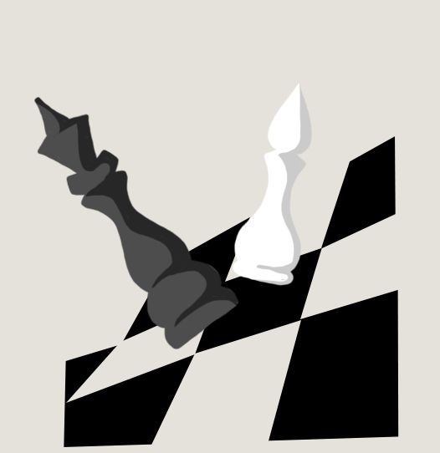
The Benefit of knowing the Answer.
For instance what would happen if people played the ⅔ game after understanding the difference between the most logical approach and most common one ?

Slide 13
Now. Let’s listen to a story.
2
Uhmmm. Yeah. It involves game theory too.

Slide 14
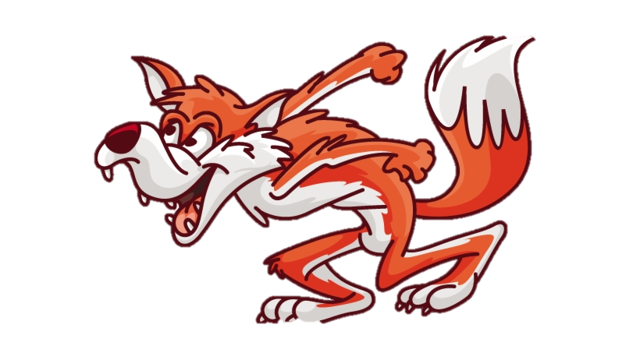


Crispy and Chewy are in trouble.

Slide 15
The dilemma.
Choose to spare or sacrifice the other.
They can discuss, but neither will know the final decision.
If both spare, the fox will eat just one of each of their limbs.
If one spares while the other sacrifices, the sparer will be fully eaten.
If both choose to sacrifice, the fox will eat three limbs from each.

Slide 16
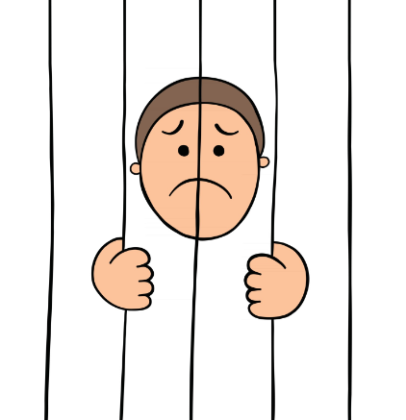
The Economics Behind.
This scenario is popularly known as the Prisoner’s Dilemma.

Slide 17
Let’s map it out.
Chewy
 | Spare | Sacrifice
Spare | 3, 3 | 0, 4
Sacrifice | 4, 0 | 1, 1
Crispy

Slide 18
What will Chewy do?
Chewy
 | Spare | Sacrifice
Spare | 3 | 0
Sacrifice | 4 | 1
Crispy

Slide 19

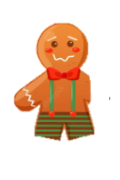
The friendship won’t last.
According to the findings of Game Theory, both the sweets will betray one another.
This strategy is what Game Theorists call the Nash Equilibrium.
Neither can gain by deviating from it.

Slide 20
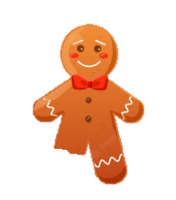

A little twist.
The gingerbread men are now doomed to repeat the dilemma infinitely.
This changes the game, as the baked goods can now use their future decisions as bargaining chips in the present.

Slide 21
The Terminologies.
3
What all is important?

Slide 22
What are the Key Elements?
Players
Relevant decision-making identities, whose utilities are interdependent.
Strategies
Complete plan of action for playing a game.
Pay-offs
Changes in welfare or utility at the end of the game.

Slide 23
What all are the different outcomes?
Socially Optimal Solution
Players choose the best possible strategy for the sum total of the players, maximizing the benefits for themselves too.
Nash Equilibrium
Players choose the best possible strategy for themselves, given everyone else playing and no individual player can benefit by choosing differently.
Notes:
SOS - Spare spare
Nash - Sacrifice Sacrifice

Slide 24
Thanks!
ANY QUESTIONS?

